Slide 1
Introduction to R
for Archaeologists
Elisabeth Hähner
10.03.2026

Slide 2



Why R?
Free & Open-Source
No expensive licenses. R is maintained by a global community and runs on Windows, Mac, and Linux.
Reproducible Research
Your analysis is saved as a script — anyone can re-run it and get the same results. No more "which button did I click?"
Powerful Visualizations
Create publication-ready plots that go far beyond what Excel can offer, with full control over every detail.
E. Hähner | Introduction to R | 10.03.2026

Slide 3






What You'll Learn Today
1
Install R & RStudio
2
Create a project
3
Load & prepare data
4
Check your data
5
Create plots with ggplot2
6
Customize & save results
E. Hähner | Introduction to R | 10.03.2026

Slide 4


What is R / RStudio?
R
RStudio
The Engine
The Dashboard
R is the programming language that does the actual computing — statistics, data manipulation, and plotting.
RStudio is the user-friendly interface (IDE) that makes working with R much easier — like a car's dashboard.
E. Hähner | Introduction to R | 10.03.2026
Notes:
Think of it like a car: R is the engine — it does all the work. RStudio is the dashboard. You'll never need to open plain R directly; always use RStudio.

Slide 5
01
Getting Started

Slide 6
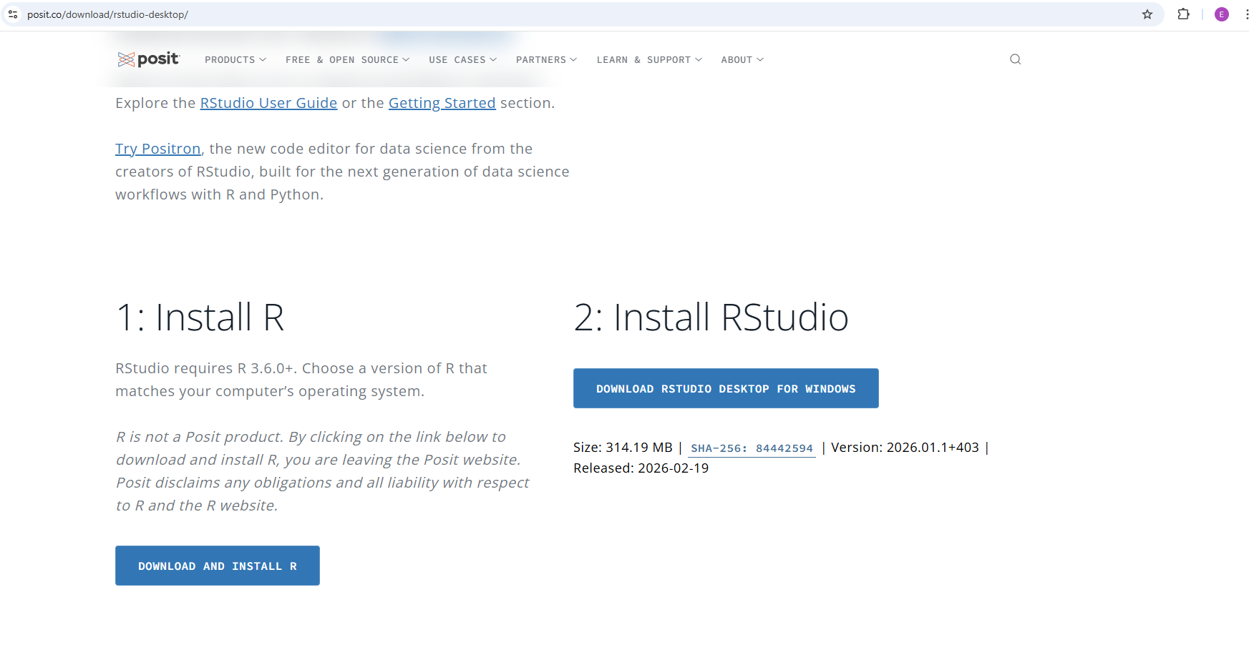

Install R and RStudio
1
Install R from CRAN
https://cran.r-project.org/
Install RStudio from Posit
https://posit.co/download/rstudio-desktop/
2
Always install R first, then RStudio. Both are completely free.
E. Hähner | Introduction to R | 10.03.2026

Slide 7
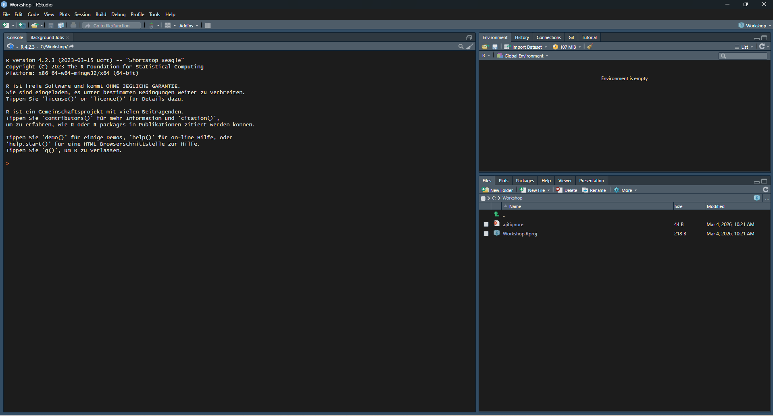
The RStudio Interface
Source Editor
Write & save scripts
Console
Run commands directly
Environment
See your variables
Files / Plots
Browse files, view plots
E. Hähner | Introduction to R | 10.03.2026
Notes:
The RStudio interface has 4 panes: 1. Source Editor (top-left): Write and save R scripts. 2. Console (bottom-left): Where R runs code. Type directly or run from Source. 3. Environment (top-right): Shows loaded data and variables. 4. Files/Plots (bottom-right): Browse files, view plots, access help.

Slide 8
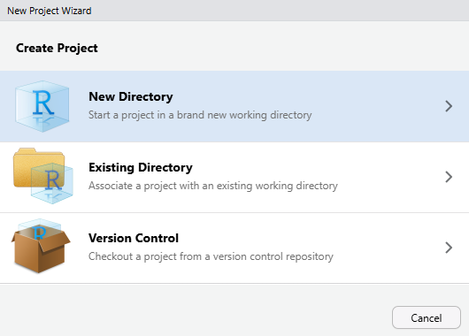
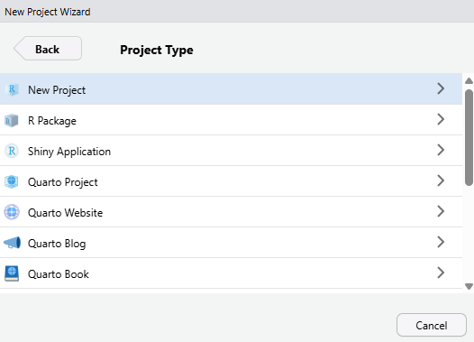
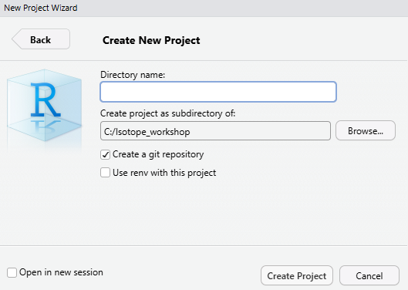
Create a New Project
Projects keep files organized and set the working directory automatically.
1. File → New Project
2. New Directory
3. Name & location
Choose a short file path — avoid spaces and special characters in folder names.
E. Hähner | Introduction to R | 10.03.2026
Notes:
Demo live: File → New Project → New Directory → New Project. Name it something like 'r-workshop'. Short path without spaces recommended. Select 'Open in new session' if another project is open.

Slide 9
Install Packages
Packages are add-ons that extend R's capabilities — like apps on a phone.
# Install packages (only needed once)
install.packages(c(
"ggplot2",
"dplyr",
"ggimage",
"writexl",
"RColorBrewer",
"systemfonts"
))
You only install once!
After installation, you load packages each session with library().
This may take a few minutes to download and install.
E. Hähner | Introduction to R | 10.03.2026
Notes:
R comes with basics, but packages add specialized tools. Install once, load every session. Installing can take a few minutes and sometimes restarting R Studio is necessary (R /R Studio will tell you).

Slide 10

Load Packages
Load packages at the start of every R session:
# Load packages (every session)
library(ggplot2)
library(dplyr)
library(ggimage)
library(writexl)
library(RColorBrewer)
library(systemfonts)
Install vs Load
install.packages()
Download once (like installing an app)
library()
Load every session (like opening an app)
If you see: "there is no package called 'X'" — run install.packages("X") first.
E. Hähner | Introduction to R | 10.03.2026
Notes:
Demo: Type library(ggplot2) and press Enter. No error = success. Show what happens when loading a package that isn't installed — the 'no package called X' error. Most common beginner mistake.

Slide 11
02
Working with Data
Notes:
Now that our environment is set up, let's get some real data into R.

Slide 12
Prepare Your CSV
Export your Excel data as CSV before loading into R.
Before (Excel CSV)
After (R-ready)
Comma as decimal: 3,14
Semicolons as field separator
Empty rows at bottom
Encoding issues (umlauts)
→
Point as decimal: 3.14
Use sep=";" in read.csv()
No empty rows
UTF-8 encoding
European Excel uses ";" as separator and "," for decimals. R expects "." for decimals.
E. Hähner | Introduction to R | 10.03.2026
Notes:
European Excel uses semicolons as separators and commas for decimals. Fix decimals with Find & Replace in Excel, or handle in R with sep and dec arguments. Delete empty rows at bottom.

Slide 13
Load Data into R
Two ways to import your CSV file:
Option 1: Code
Option 2: Click
# Opens a file picker
df <- read.csv(
file.choose(),
sep = ";",
header = TRUE
)
1. Go to "Environment“ pane
2. Click "Import Dataset"
3. Select "From Text (base)"
4. Browse to your CSV file
5. Set separator to Semicolon
6. Check the data preview
7. Click "Import"
file.choose() opens a file picker dialog.
E. Hähner | Introduction to R | 10.03.2026
Notes:
Show both methods. Code (Option 1) is better for reproducibility. GUI (Option 2) is more intuitive. sep=";" is needed for European CSVs.

Slide 14
Look at Your Data
Always inspect your data after loading:
head(df)
str(df)
Shows the first 6 rows of your data
Shows structure: column names, types, sample values
summary(df)
View(df)
Min, max, mean, and quartiles for each column
Opens a spreadsheet-like viewer (capital V!)
E. Hähner | Introduction to R | 10.03.2026
Notes:
Always inspect after loading! - head(df): Quick peek at first rows. - str(df): Check types — numbers should be 'num', not 'chr'. - summary(df): Spot outliers. - View(df): Note capital V!, other with small letters, otherwise you will get error function not found
-

Slide 15
Check for Problems
Missing Values
Wrong Column Types
# Check for any missing values
is.na(df)
# Count missing in one column
sum(is.na(df$d15N))
# Count missing in all columns
colSums(is.na(df))
# Check types
str(df)
# Convert text to number
df$d15N <- as.numeric(df$d15N)
# Convert to factor
df$Species <- as.factor(df$Species)
Missing values cause warnings in plots and calculations. Fix them before continuing!
E. Hähner | Introduction to R | 10.03.2026
Notes:
Missing values cause warnings. If str(df) shows 'chr' where you expect 'num', data has text where numbers should be. Use as.numeric() to convert. df$column_name accesses a specific column — $ means 'inside this data frame, get this column'.

Slide 16
Useful Commands — Part I
Working Directory
Saving Data
# See current working directory
getwd()
# Change working directory
setwd("C:/Users/name/Documents/project")
# Save as CSV
write.csv(df, "my_results.csv")
# Save as Excel
writexl::write_xlsx(df, "results.xlsx")
When you use projects, R automatically sets the working directory to your project folder.
E. Hähner | Introduction to R | 10.03.2026
Notes:
Working directory = where R looks for files and saves output. With projects, it's automatic. getwd() shows current location. For saving: write.csv() is built-in; write_xlsx() needs the writexl package.

Slide 17
Creating a separate output folder
Creating a folder “tables”
Saving to the folder “tables”
# create output folder
if (!dir.exists("./tables")) {
dir.create("./tables", recursive = TRUE, showWarnings = FALSE)}
tab_output_dir <- file.path("./tables")
tab_output_dir <- "tables"
# we take the defined output direction and choose a name for our file
full_path <- file.path(tab_output_dir, “Collagen_Results_Maidanetske.xlsx”)
# Save as Excel
writexl::write_xlsx(summary_df, full_path)
Separate output folder can be very useful if you are going to create a lot of tables/figures
E. Hähner | Introduction to R | 10.03.2026
Notes:
Working directory = where R looks for files and saves output. With projects, it's automatic. getwd() shows current location. For saving: write.csv() is built-in; write_xlsx() needs the writexl package.

Slide 18
Key Concepts Recap
Variables
Functions
x <- 42
name <- "bone"
mean(x)
read.csv(file)
Store values with <- (the arrow)
Do things with function(argument)
Data Frames
Comments
df$column_name
df[1, 2]
# This is a comment
# R ignores text after #
Tables of data; access with $ or [ ]
Explain your code with #
E. Hähner | Introduction to R | 10.03.2026
Notes:
Pause for questions here. These four concepts are the building blocks: variables store data, functions do things, data frames are tables, and comments explain your code.

Slide 19
03
Creating Plots
Notes:
Time to visualize your data with ggplot2 — R's most popular plotting package.

Slide 20



The Grammar of ggplot2
Every ggplot has three essential components:
+
+
Data
Aesthetics
Geometry
Your data frame
(what to plot)
Mappings like x, y, color
(how to map it)
geom_point, geom_line, ...
(what shape to draw)
ggplot(data = df, aes(x = d13C, y = d15N)) + geom_point()
E. Hähner | Introduction to R | 10.03.2026
Notes:
Think of ggplot2 like building in layers. You start with data, map variables to visual properties (aesthetics), then choose a geometry (shape). The '+' operator adds layers. This is the 'grammar of graphics' — a consistent, logical way to build any plot.

Slide 21
Your First Scatter Plot (1/2)
# Basic scatter plot
ggplot(
data = df,
aes(x = d13C, y = d15N)
) +
geom_point()
# Add color by species
ggplot(
data = df,
aes(x = d13C, y = d15N,
color = Species)
) +
geom_point(size = 3)
Walk through each line:
data = df → which dataset to use
aes() → map columns to axes & color
geom_point() → draw points
E. Hähner | Introduction to R | 10.03.2026
Notes:
Walk through each line of code. data= says which dataset to use. aes() maps columns to visual properties — x-axis, y-axis, color. geom_point() says 'draw points'. The + connects layers. Show how adding color=Species automatically creates a legend.

Slide 22
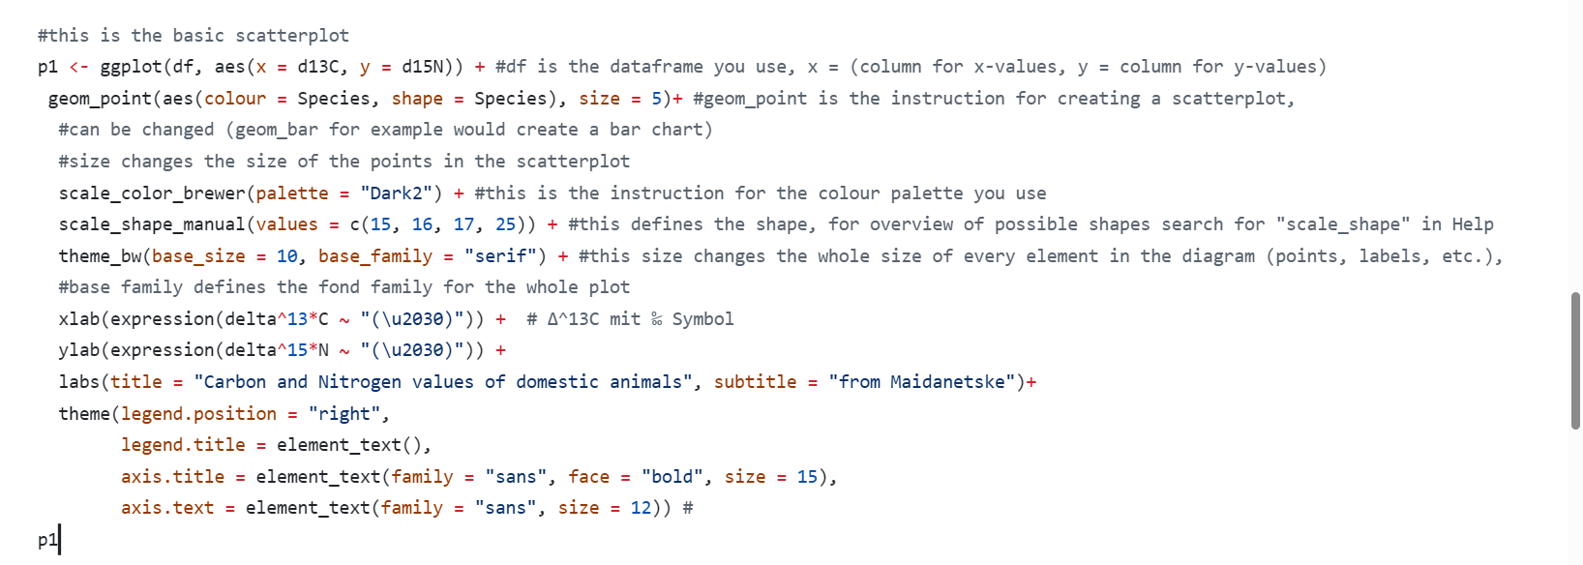
Your First Scatter Plot (2/2)
E. Hähner | Introduction to R | 10.03.2026
Notes:
Walk through each line of code. data= says which dataset to use. aes() maps columns to visual properties — x-axis, y-axis, color. geom_point() says 'draw points'. The + connects layers. Show how adding color=Species automatically creates a legend. Run “p1” at the end or type into console, otherwise R is creating the plot, but you won’t see it.

Slide 23
Customize Your Plot
# Add labels and a clean theme
ggplot(df, aes(x = d13C, y = d15N,
color = Species)) +
geom_point(size = 3) +
labs(
title = "Stable Isotopes by Species",
x = expression(delta^13*C~"\u2030"),
y = expression(delta^15*N~"\u2030")
) +
scale_color_brewer(palette = "Set2") +
theme_bw()
Key Functions
labs()
Add title, subtitle, axis labels
scale_color_brewer()
Use ColorBrewer palettes
theme_bw()
Clean black-and-white theme
theme()
Fine-tune fonts, sizes, margins
Good Overview of existing themes is in the ggplot2-book: https://ggplot2-book.org/themes.html
E. Hähner | Introduction to R | 10.03.2026
Notes:
theme_bw() is a great starting point — clean and professional. labs() adds titles and axis labels. The expression() function creates proper delta notation with superscripts for isotope axes.

Slide 24
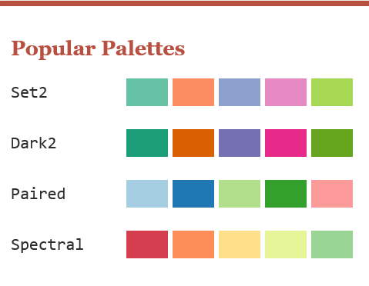
Colours (2 options with palette or manual)
# See all available palettes
display.brewer.all()
#choose a palette for your plot
scale_color_brewer(palette = "Dark2") +
# set colours for species manually
farben <- c("Wild animals" = “green", "Pig (Sus scrofa f. domestica)" = “pink", "Dog (Canis lupus f. familiaris)" = “chocolate", "Cattle (Bos primigenius f. taurus)" = "#blue", "Sheep/Goat (Ovis/Capra)" = "#orange“)
# integrate into plot code
P + scale_colour_manual(values = farben)
To see available colours: colors()
Check color Blindness for manual colors:
colorblindcheck::palette_plot(farben, severity = 1, show_hex = TRUE)
To check for color Blindness with package “colorblindcheck”:
palette_check(brewer.pal(5, “Dark2”), plot = TRUE)
E. Hähner | Introduction to R | 10.03.2026
Notes:
Type display.brewer.all() in console, to see all pre-defined colour palettes. Be aware that the palettes have different numbers of available colours. There is also the possibility to set the colours manual, recommended if you have different types of plots, and want always the same colour per Species. For both options there are ways to check if there are working for color blind people. Therefor you have to install and load the package “colorblindcheck”.

Slide 25
Fonts
# See installed system fonts
systemfonts::system_fonts()
# to see the first 50 system fonts
print(system_fonts(), n = 50)
Font face options:
plain | italic | bold | bold.italic
# Change font in your plot
theme(
axis.title = element_text(
family = "serif",
face = "bold",
size = 15)
)
E. Hähner | Introduction to R | 10.03.2026
Notes:
For fonts: 'serif', 'sans', and 'mono' are the main families, but you can also use any installed system font by name.

Slide 26
Animal Silhouette Plots
Use the ggimage package to add animal silhouettes to your scatter plot:
# Load images and assign to species
df <- df %>%
mutate(image = case_when(
Species == "Cattle" ~ "./cattle.svg",
Species == "Sheep" ~ "./sheep.svg",
Species == "Pig" ~ "./pig.svg",
TRUE ~ "./other.svg"
))
# Plot with silhouettes
ggplot(df, aes(x = d13C, y = d15N)) +
geom_image(aes(image = image), size = 0.05) +
theme_bw()
How it works:
1. dplyr::mutate() adds a new column
2. case_when() matches species to image files
3. geom_image() draws the silhouettes
SVG or PNG images both work.
E. Hähner | Introduction to R | 10.03.2026
Notes:
This is the project-specific part using animal silhouettes. The ggimage package lets you use images as plot points instead of circles. We use dplyr's mutate() and case_when() to assign the correct image file to each species. The images should be in your project folder. SVG format works best for scaling. Source for silhouettes: PhyloPic (https://www.phylopic.org/) provides free silhouettes of organisms.

Slide 27
Saving Plots & Results
Save Plots
Save Data
# Save as PNG (for presentations)
ggsave("my_plot.png",
width = 8, height = 6,
dpi = 300)
# Save as SVG (for publications)
ggsave("my_plot.svg",
width = 8, height = 6)
# Save as CSV
write.csv(df, "results.csv",
row.names = FALSE)
# Save as Excel
library(writexl)
write_xlsx(df, "results.xlsx")
ggsave() saves the last plot you created. Use SVG for publications (vector), PNG for presentations (raster).
E. Hähner | Introduction to R | 10.03.2026
Notes:
ggsave() saves the last plot displayed. PNG at 300 DPI is good for presentations and posters. SVG is vector-based — it scales perfectly for publications. Always specify width and height for consistent sizing.

Slide 28
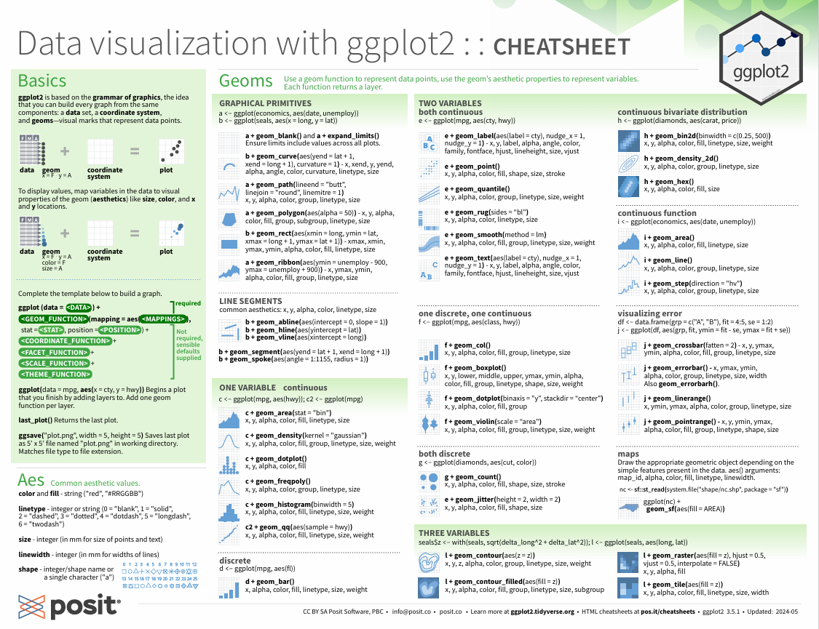
The ggplot cheat sheet
Where to find:
In R:
Help > Cheat Sheet > Data visualization with ggplot2
via web search:
https://posit.co/wp-content/uploads/2022/10/data-visualization-1.pdf
the used data “mpg” is a pre-installed data frame: write mpg in your console to see it
E. Hähner | Introduction to R | 10.03.2026
Notes:
Help is the Help button on the top menu next to “Tools”, not the “Help” you find on the right-hand side next to “Packages”. But both will lead you forward, searching for “ggplot” in the other “help” menu will also give you advice and refers to the ggplot2 book

Slide 29
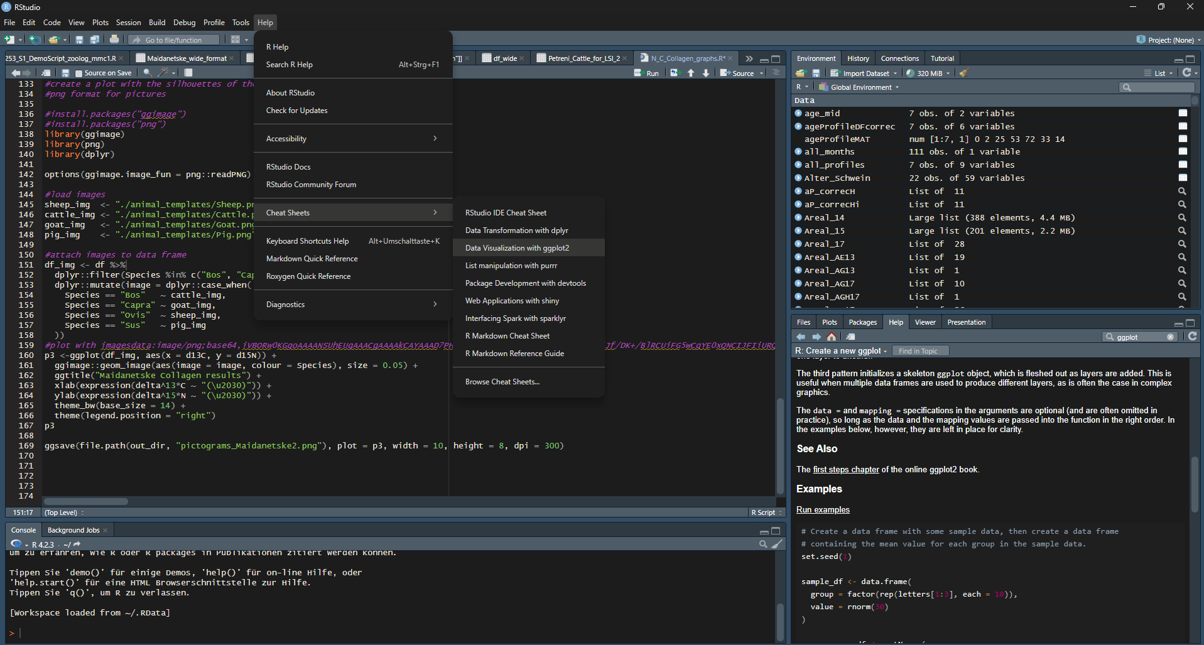
Getting Help
RStudio Help pane
E. Hähner | Introduction to R | 10.03.2026
Notes:
The ggplot2 cheat sheet is your best friend — download it and keep it open. The ? prefix brings up help for any function. Stack Overflow has answers to nearly every R question. The ggplot2 book (ggplot2-book.org) is the comprehensive reference by Hadley Wickham.

Slide 30



Getting Help
Built-in Help
Type ?function_name in console (e.g., ?ggplot)
ggplot2 Book
Free online: https://ggplot2-book.org/
Cheat Sheets
https://posit.co/resources/cheatsheets/
Stack Overflow
Search "[r] your question" for community answers
RStudio Help pane
E. Hähner | Introduction to R | 10.03.2026
Notes:
The ggplot2 cheat sheet is your best friend — download it and keep it open. The ? prefix brings up help for any function. Stack Overflow has answers to nearly every R question. The ggplot2 book (ggplot2-book.org) is the comprehensive reference by Hadley Wickham.

Slide 31
04
Wrap-up
Notes:
Let's review what we've learned and look at next steps.

Slide 32



Tips & Best Practices
Use lowercase names
For files, folders, and variables — consistent and avoids errors
Comment your code
Use # to explain what each section does — your future self/other researchers will thank you
Save scripts, not console
Write code in the Source Editor and save as .R files for reproducibility
Use projects
Keep all files together with RStudio Projects — working directory is set automatically
E. Hähner | Introduction to R | 10.03.2026
Notes:
Consistency saves hours of debugging. Key habits: lowercase everything, comment generously, save scripts (not just console commands), and always use projects. These seem small but they prevent the most common frustrations.

Slide 33
Resources & Next Steps
ggplot2 Documentation
Official reference with examples for every function
https://ggplot2.tidyverse.org/
R for Data Science (2e)
Free online book — the best intro to R and the tidyverse
https://r4ds.hadley.nz/
RStudio Cheat Sheets
Printable quick-reference guides for ggplot2, dplyr, and more
https://posit.co/resources/cheatsheets/
CRAN — The R Archive
Browse and install any of R's 20,000+ packages
https://cran.r-project.org/
This Workshop's Repository
Scripts, data, and slides from today — reference: Makarewicz et al. 2022
https://github.com/ellihaehner/N_C_Collagen_graphs
E. Hähner | Introduction to R | 10.03.2026
Notes:
Encourage self-study: R for Data Science is the gold standard intro book and it's completely free online. The cheat sheets are invaluable — print the ggplot2 one. The workshop repository has all the scripts and data from today.

Slide 34
Thank You!
Elisabeth Hähner
Questions? Feedback? Get in touch!
Notes:
Thank everyone for participating. Open the floor for questions. Remind them: the slides and scripts are available in the repository. Encourage them to practice on their own data.

Slide 35
05
Backup & FAQ
Notes:
Reference slides for common questions and troubleshooting.

Slide 36
FAQ: Common Beginner Questions
What's the difference between <- and = ?
Both assign values. <- is the R convention and preferred. = also works but can be ambiguous in function arguments.
Why do I get "object not found"?
The variable doesn't exist yet. Check spelling (R is case-sensitive!) and make sure you ran the line that creates it.
How do I undo something?
Ctrl+Z in the Source Editor. In the console, there's no undo — but you can re-run your script from the top.
What is a data frame?
A table of data with rows and columns — like an Excel spreadsheet. Each column can hold numbers, text, or other types.
E. Hähner | Introduction to R | 10.03.2026
Notes:
These are the most common questions from beginners. The <- vs = distinction trips people up but isn't critical — just use <-. 'Object not found' is almost always a typo or forgetting to run a line.

Slide 37
FAQ: Data & Plotting Questions
My plot is empty — why?
Check: Did you add a geom layer (e.g., geom_point())? Is your data loaded? Do column names match exactly?
How do I change point sizes?
Add size = 3 inside geom_point(). For mapping size to a variable, put it inside aes(): aes(size = variable).
Can I use my own colors?
Yes! Use scale_color_manual(values = c("red", "blue")) or hex codes like "#B85042".
How do I add a title?
Add + labs(title = "My Title") to your ggplot. Also works: subtitle, x, y, caption.
E. Hähner | Introduction to R | 10.03.2026
Notes:
'My plot is empty' is the #1 plotting question. It's almost always a missing geom layer or a typo in column names. The other common questions are about customization — ggplot2 is incredibly flexible.

Slide 38
Troubleshooting: Installation
"Rscript not found"
R is not in your system PATH. Reinstall R and check "Add to PATH" during installation.
"there is no package called X"
The package isn't installed. Run install.packages("X"). Check spelling — package names are case-sensitive.
Package install fails on Mac
You may need Xcode command line tools. Run xcode-select --install in Terminal.
Package install fails on Windows
Try running RStudio as Administrator. Check your internet connection. Some packages need Rtools.
E. Hähner | Introduction to R | 10.03.2026
Notes:
These are installation problems you might encounter. Most can be solved by reinstalling or running as admin. Mac users sometimes need Xcode tools.

Slide 39
Troubleshooting: Data & Code
"No CSV files found"
Check your working directory with getwd(). Make sure the CSV is in the right folder, or use file.choose().
"could not convert to numeric"
Your column has text mixed with numbers. Check for typos, extra spaces, or comma decimals.
"unexpected symbol" or "unexpected )"
Missing comma, quote, or parenthesis. Check the line above the error — that's often where the real problem is.
"missing required columns"
Column names in your code don't match the CSV. Use names(df) to see actual column names. Watch for spaces and case.
E. Hähner | Introduction to R | 10.03.2026
Notes:
Data errors are the most frustrating. 'Unexpected symbol' almost always means a missing comma or bracket on the previous line. Column name mismatches are extremely common — R is case-sensitive.

Slide 40
R Glossary
Variable
A named container for data: x <- 42
Argument
A value passed to a function: read.csv(file, sep=";")
Function
A reusable command: mean(), read.csv(), ggplot()
Console
The interactive command line in RStudio
Package
An add-on library: install once, load each session
Script
A saved file of R commands (.R file)
Data Frame
A table of rows and columns (like a spreadsheet)
Working Directory
The folder R uses to read/write files
Vector
A list of values of the same type: c(1, 2, 3)
CRAN
The Comprehensive R Archive Network — where packages live
E. Hähner | Introduction to R | 10.03.2026
Notes:
This glossary covers all the key terms from the workshop. Print it out or save it as a quick reference.

Slide 41
sources
Kühne, M. Einführung in R, Dresden. https://tu-dresden.de/gsw/phil/iso/mes/ressourcen/dateien/prof/lehre/freieS/Dateien/Einfuehrung_R.pdf?lang=de 03/09/2026
Baxter, M., & Cool, H. (2016). Basic statistical graphics for archaeology with R: Life beyond Excel.Barbican Research Associates, Nottingham. http://www.barbicanra.co.uk/assets/basic-statisti-cal-graphics.pdf last accessed 03/09/2026
https://www.produnis.de/R/statistik-mit-R.html 03/09/2026
https://bsc-biodiv-der-pflanzen-zizka-df3996514e4d00205673a00a6d55070dc.pages.uni-marburg.de/book/05_einf%C3%BChrung_in_R.html 03/09/2026
https://cran.r-project.org/web/packages/colorblindcheck/vignettes/intro-to-colorblindcheck.html 03/09/2026
E. Hähner | Introduction to R | 10.03.2026
Notes:
This glossary covers all the key terms from the workshop. Print it out or save it as a quick reference.

